Slide 1
Creating YouTube Videos to Support Mathematics Classes
Denny Burzynski
Western Nevada College
Carson City, NV
April, 2024

Slide 2
Three decades ago, I took guitar lessons from a fellow in San Francisco, Roger Rocha, hoping to learn how to play surf guitar music like Dick Dale’s Miserlou or the Langhorns’ The Quiet Surf.

Slide 3
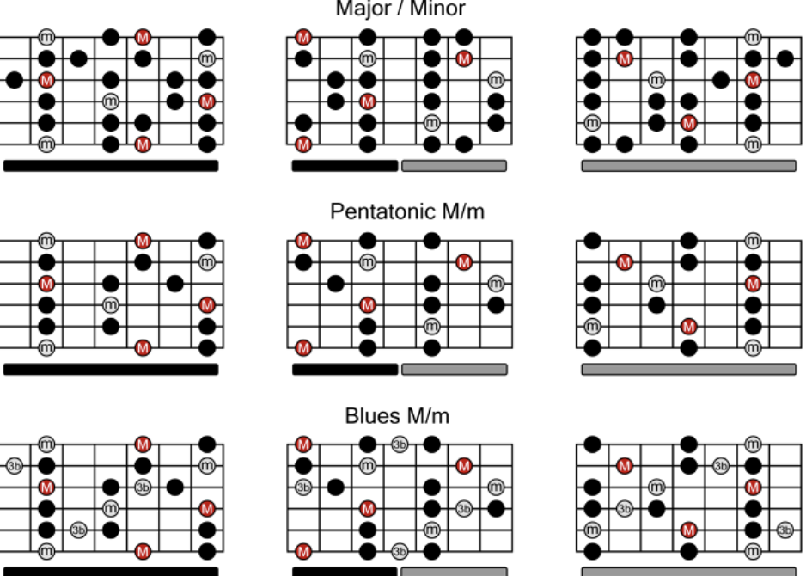
Roger would help
me to learn scales

Slide 4
Lessons were 45 minutes long and I was excited about the music and enthusiastic about learning it.

Slide 5
While I was sitting and working together with him, the scales made sense and I could play parts of those tunes.

Slide 6
But, by the time I got to my car, I forgot almost everything he had showed me.

Slide 7
I found videos on YouTube that helped me with scales similar to those Roger showed me during our lesson.

Slide 8
It was almost like having someone sitting next to me helping me through the music.

Slide 9
Now, my Co-Req College Algebra classes go for about
2 hours and my students and I work together through a lot of example problems.

Slide 10
While we are together, they do pretty well with the material.

Slide 11
And although they are enthusiastic and excited to be there, by the time they get to their cars, they have forgotten almost everything we did in class.

Slide 12
They need someone there with them working through the problems.

Slide 13
I decided to create videos of me working through exercises similar to those in the homework. It would be like me sitting with a student as a guide.

Slide 14
For homework, I use
MML and XYZ.

Slide 15
I decided to create a YouTube channel and work through every assigned homework problem.

Slide 16
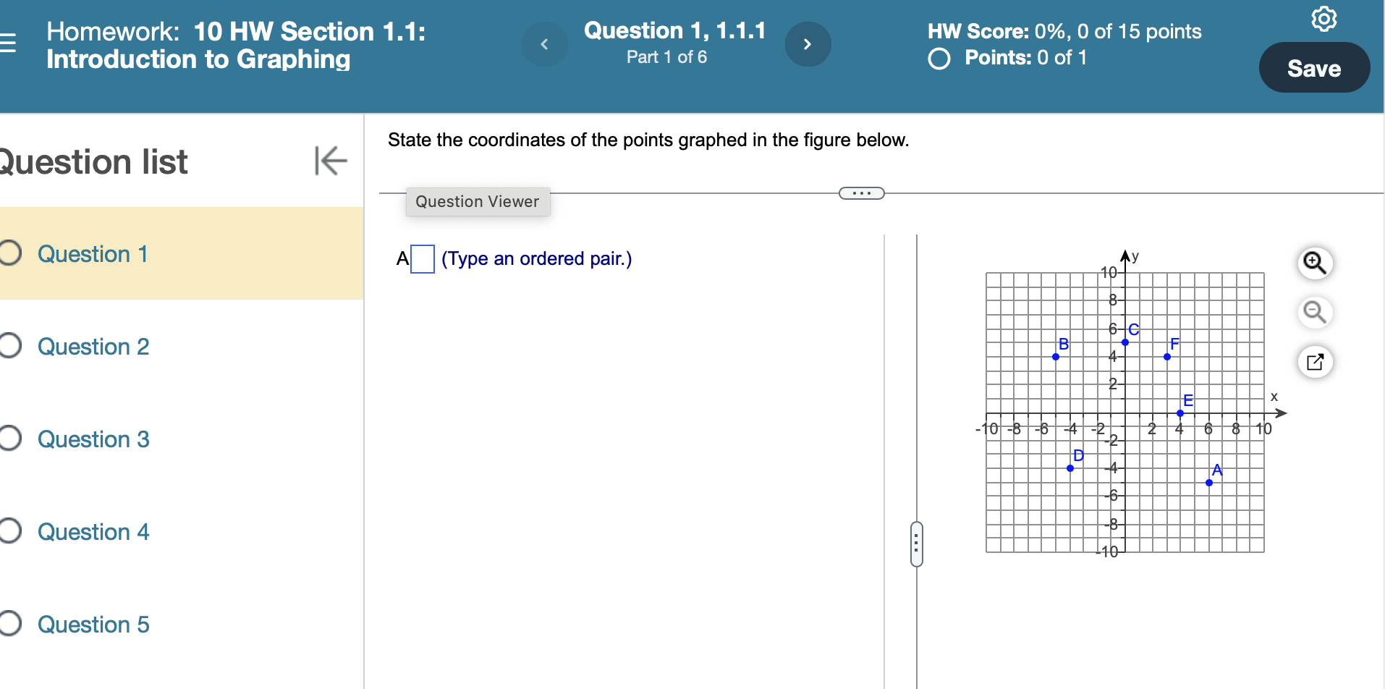

Slide 17
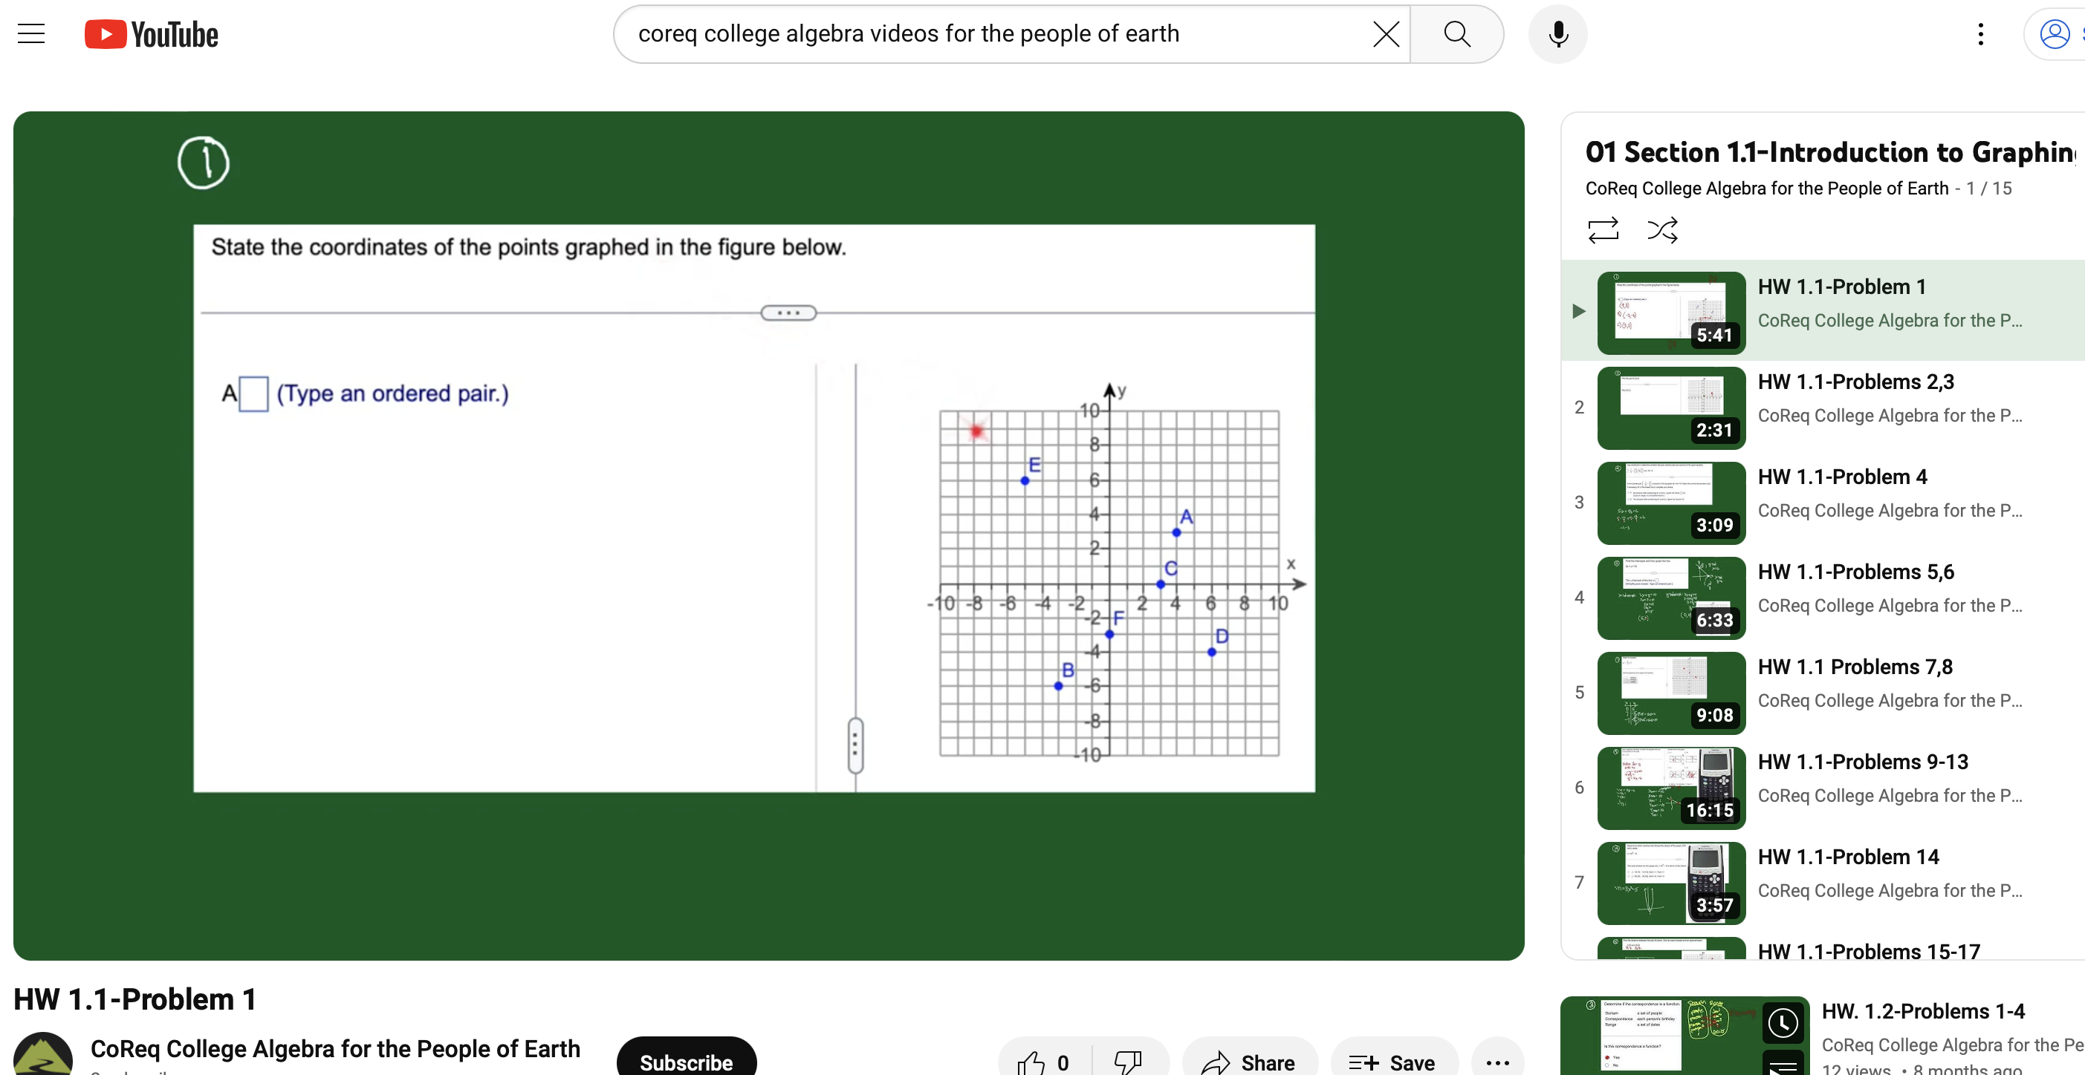

Slide 18
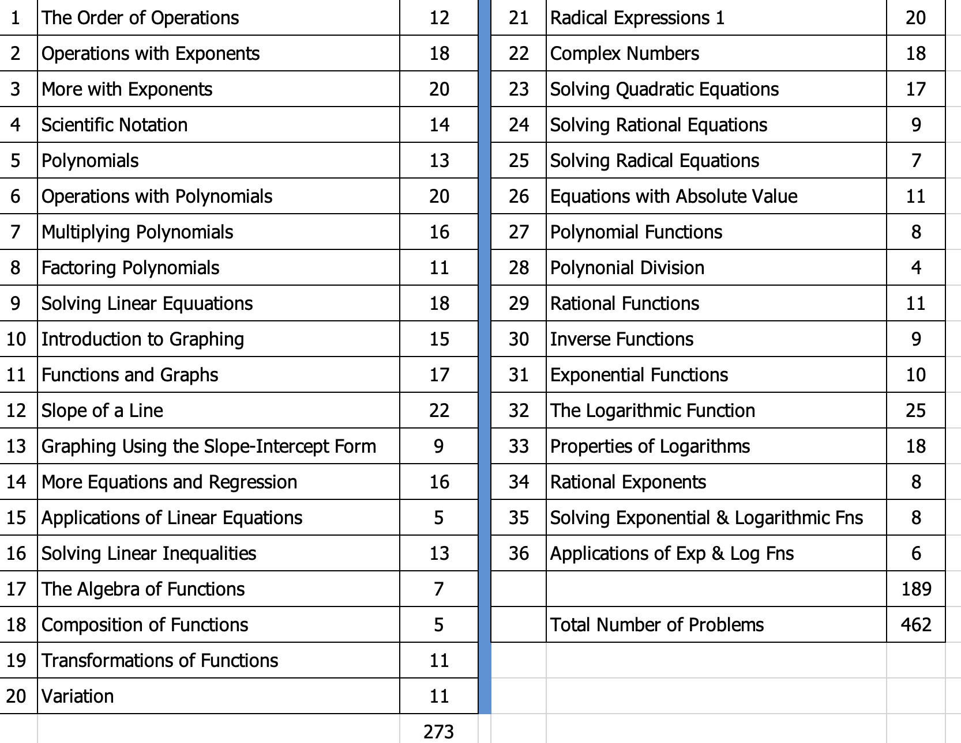

Slide 19
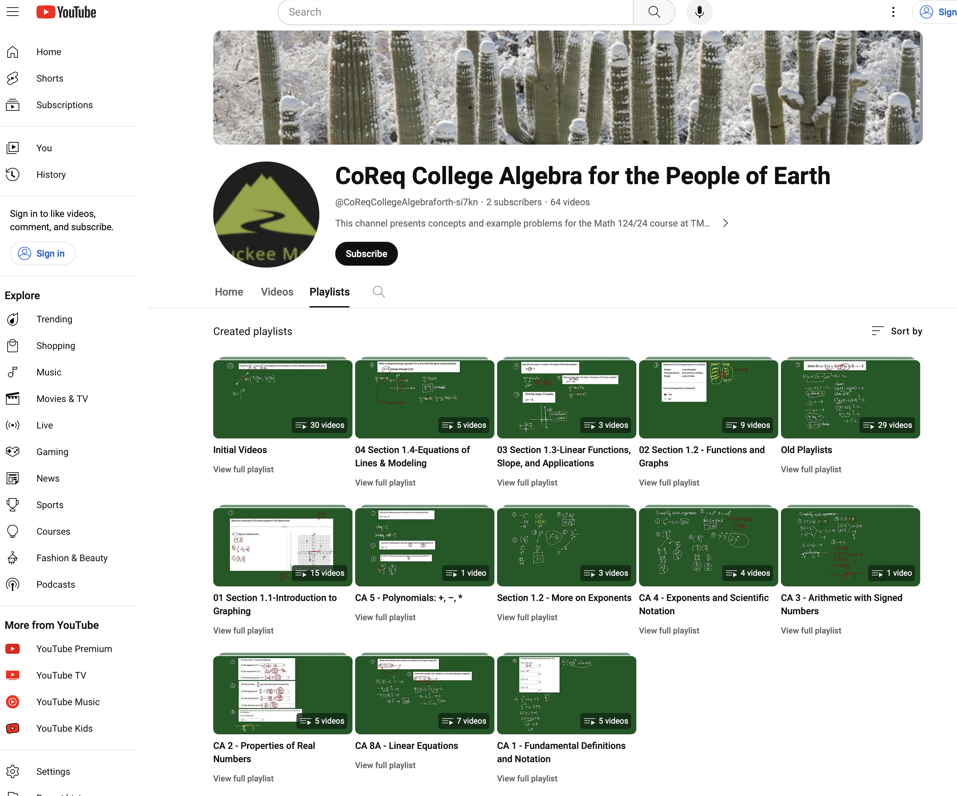

Slide 20
I have a channel for every class I teach.

Slide 21
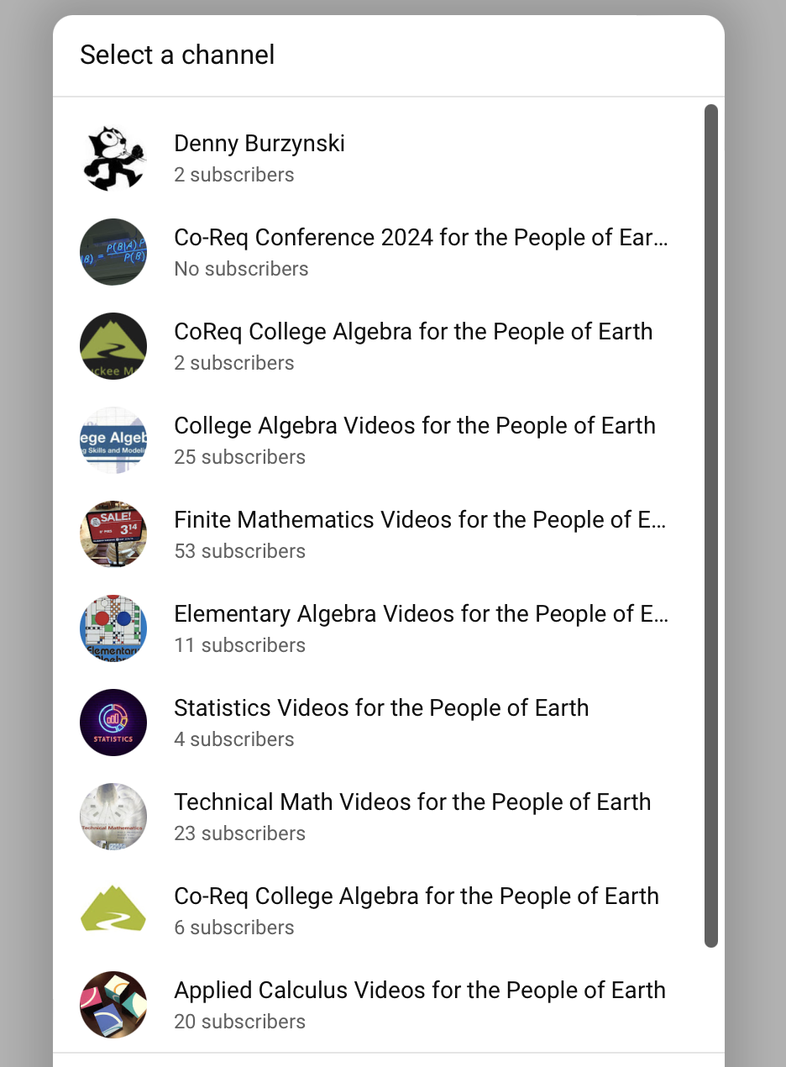

Slide 22
I use the iPad app
Vittle
Vittle Pro Video Whiteboard

Slide 23
Vittle is a screencast recorder
It records what I write on my iPad
I then upload the recording to my YouTube channel

Slide 24
Demonstration
using the
CoReq College Algebra Videos for the
People of Earth
For the spring 2024 class at TMCC

Slide 26
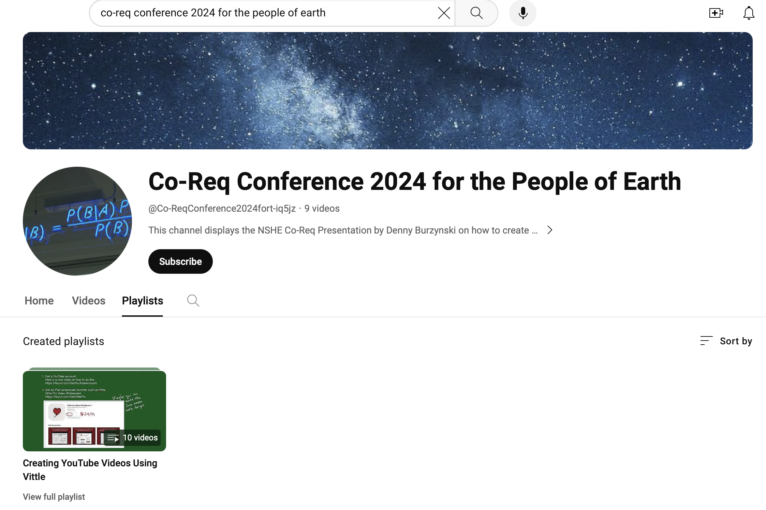

Slide 27
The city of Las Vegas requires that all conference presenters end their presentations this way:

Slide 28
