Slide 1
Using Technology in Math 124E Co-requisite College Algebra
Denny Burzynski
NSHE Math Co-Req
Collaboration Conference
February 23-34
The College of Southern Nevada

Slide 2
Most of us here use some kind of technology in our classes.
There was a time when most mathematics faculty did not.
It was (maybe still is) a common belief that using technology was teaching calculating and not mathematics.

Slide 3
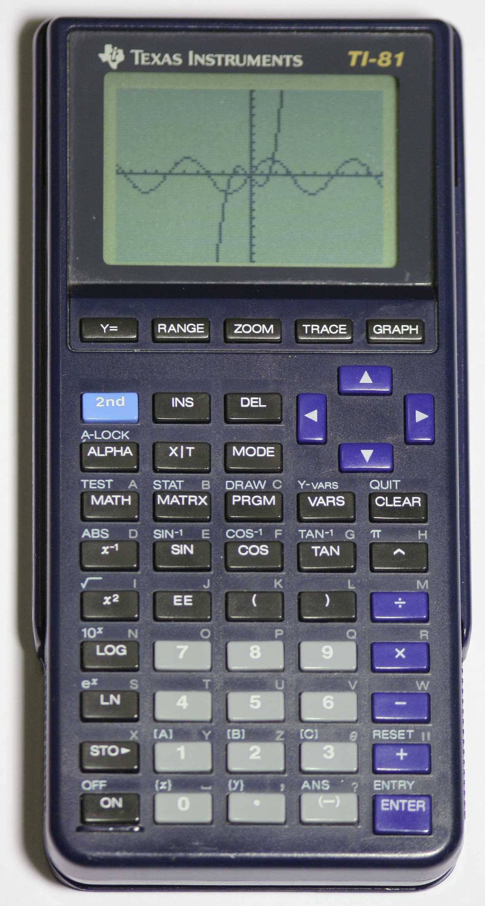
At some point, things changed – here we all are now.
Texas Instruments introduced the
TI-81 Graphing Calculator in about 1990.

Slide 4
In 1991 or 1992, at a CMC^3-S Conference in Costa Mesa, CA, Wade Ellis, Jr. of West Valley College in Saratoga, CA (Silicon Valley) gave a talk titled something like
Using the TI-81 Graphing Calculator in Your Mathematics Classroom

Slide 5
The room was packed, people were standing and even looking in from outside the door.
People wanted to know just what was going on here.
Calculators in a math class?
What the …

Slide 6
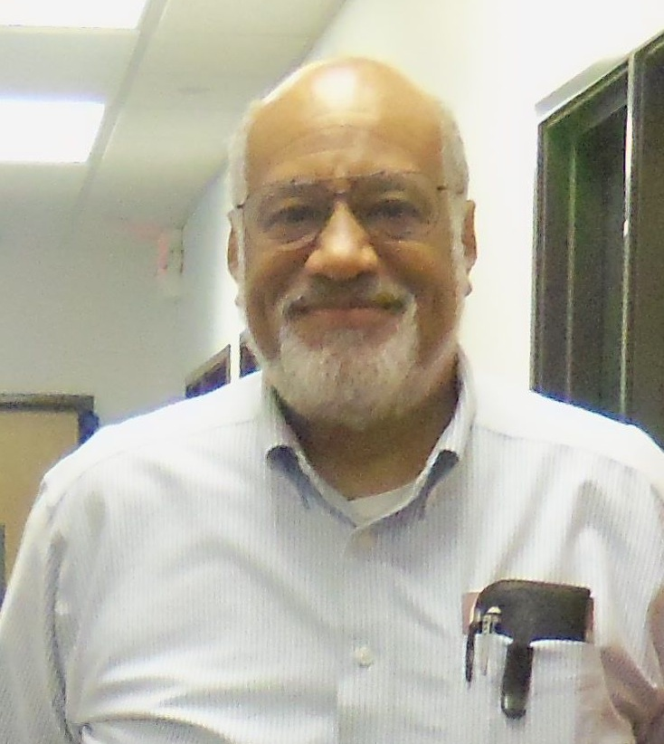
Wade started discussing how the TI-81 could be used to help teach mathematics
and

Slide 7
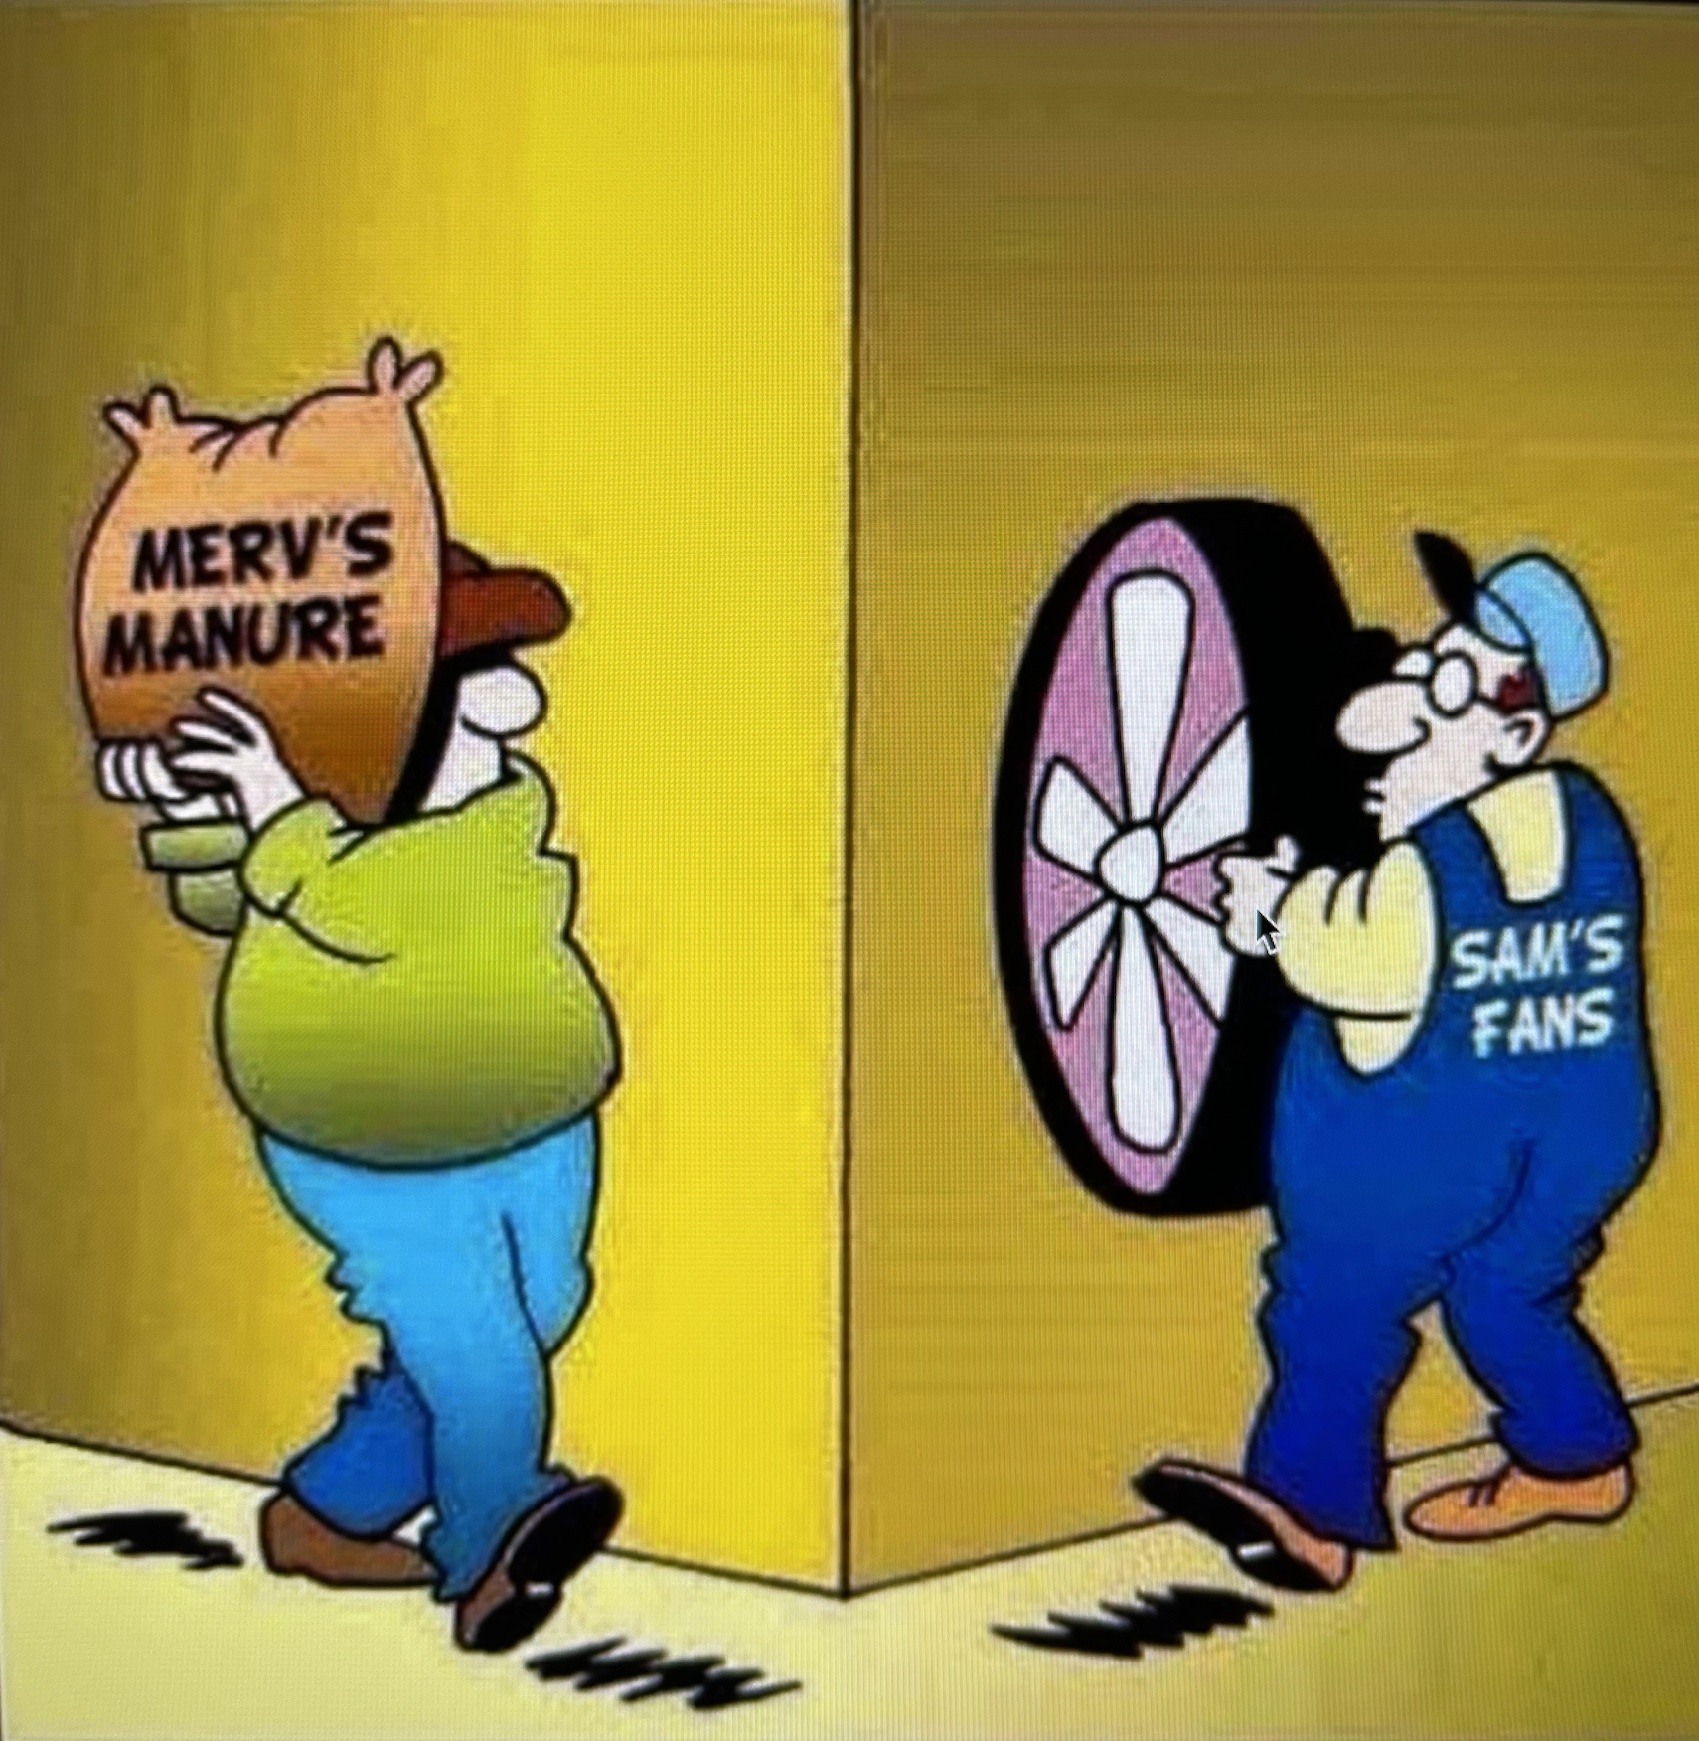

Slide 8
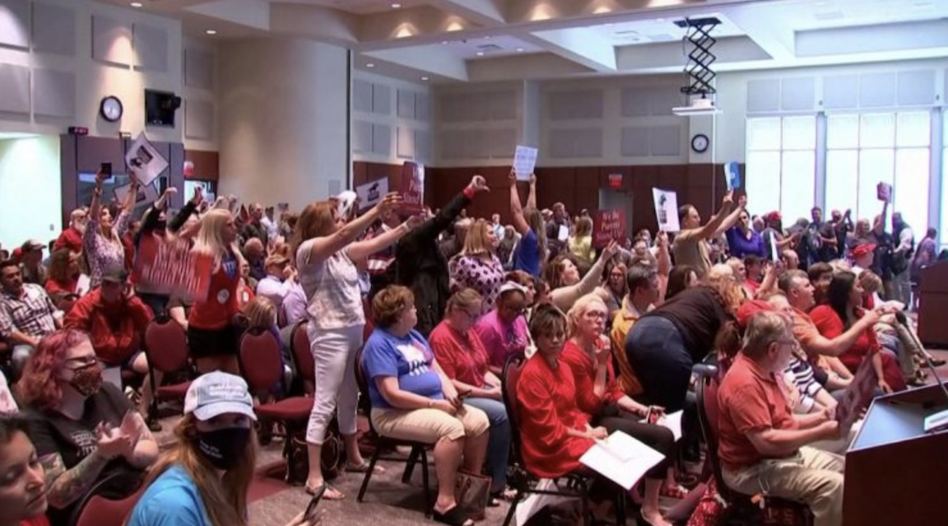
People were really upset and began yelling at Wade.
Chaos

Slide 9
I have heard it said that the reasoning skills learned in mathematics courses can be transferred to other areas. But there seems to be no evidence to back up this claim.

Slide 10
In fact, the mathematician Morris Kline of NYU, wrote There is some question about whether the training to think in one sphere carries over to thinking in another. One may be inclined to believe that it does, but one could not prove that it is so.

Slide 11
Peter Johnson of the Eastern Connecticut University states that There appears to be no research whatever that would indicate that the kind of reasoning skills a student is expected to gain from learning algebra would transfer to other domains of thinking or problem solving or critical thinking in general.

Slide 12
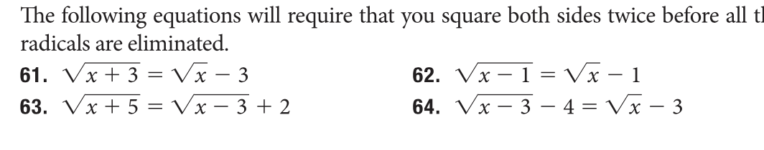
Why do we require non-STEM students to do this with a pencil?
What purpose
does it serve?

Slide 13
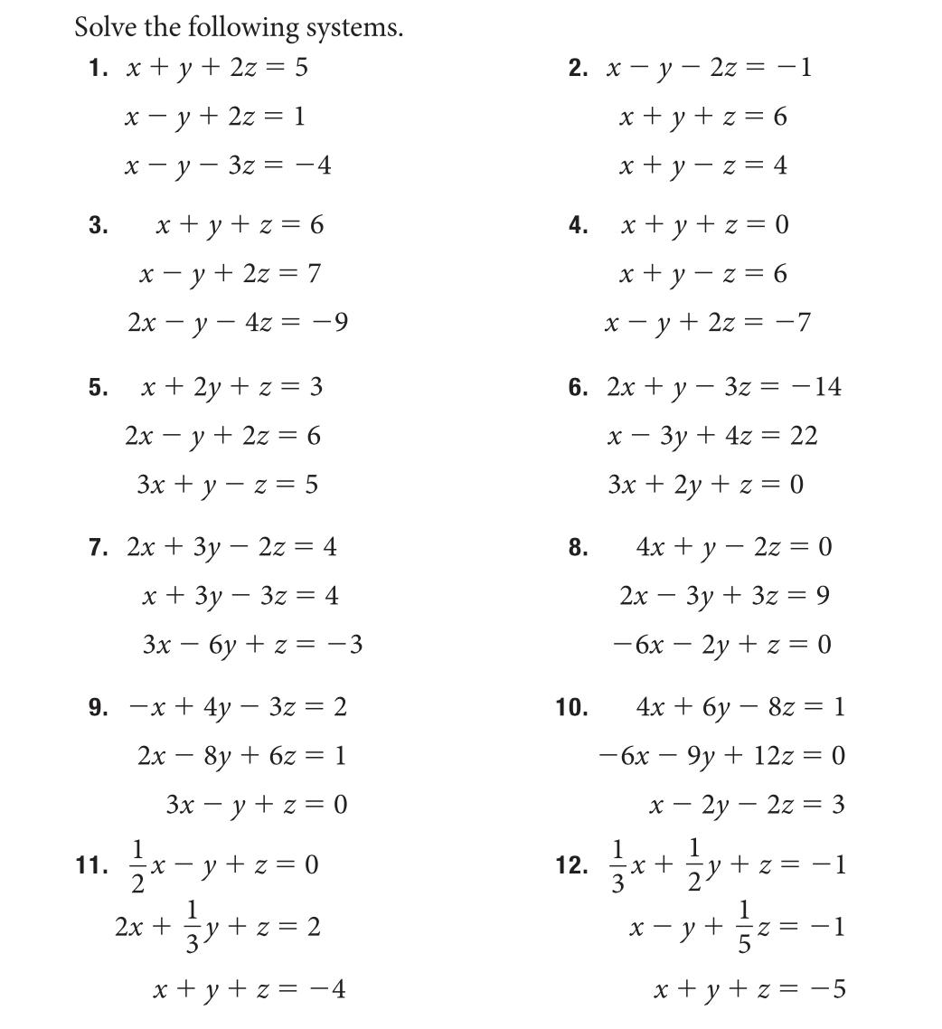

Slide 14
As the CSN Math 124E Committee began constructing the co-requisite course, we invited a faculty member of the CNS Business Department to discuss the mathematical needs of Business and Management.

Slide 15

He noted that his department faculty were astonished that students were coming to them from the mathematics department without knowing how to use technology.

Slide 16
They want their students to have been introduced to technology such as Excel and the TI-84 and even computer algebra systems so they can work through the mathematics that occur in their courses.

Slide 17
They had to teach the students we sent them how to use technology to solve the mathematics problems that occur in their business & management classes.

Slide 18
This fellow reminded us that 124 is a service course, a course that prepares non-STEM students for courses in the Business, Humanities, Arts, and Literature.

Slide 19
At CSN we chose to include and develop course material that provides instruction using the
TI-84 &
WolframAlpha
No Excel
just yet

Slide 20
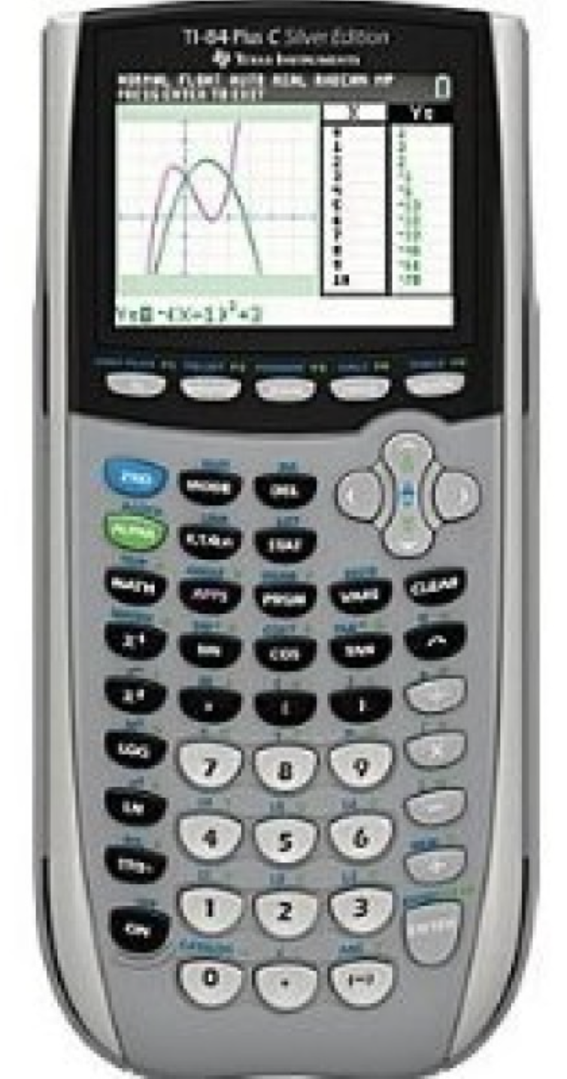
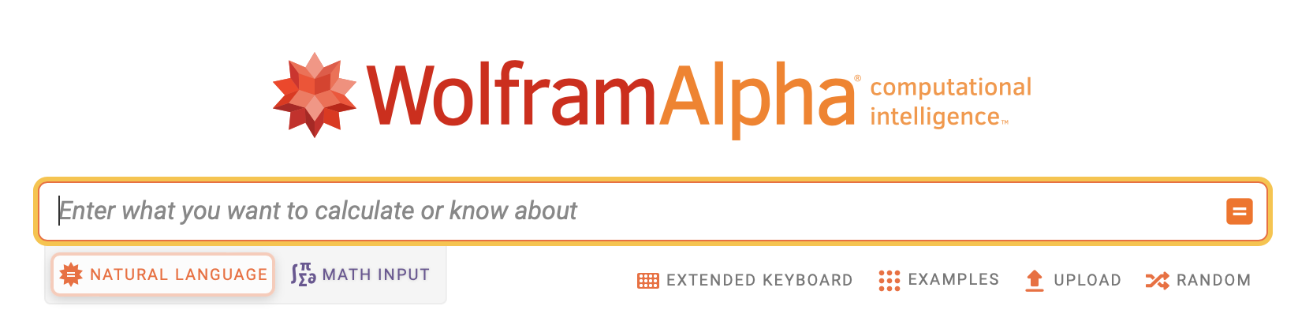
We created a collection of assignments that require technology to complete.

Slide 21
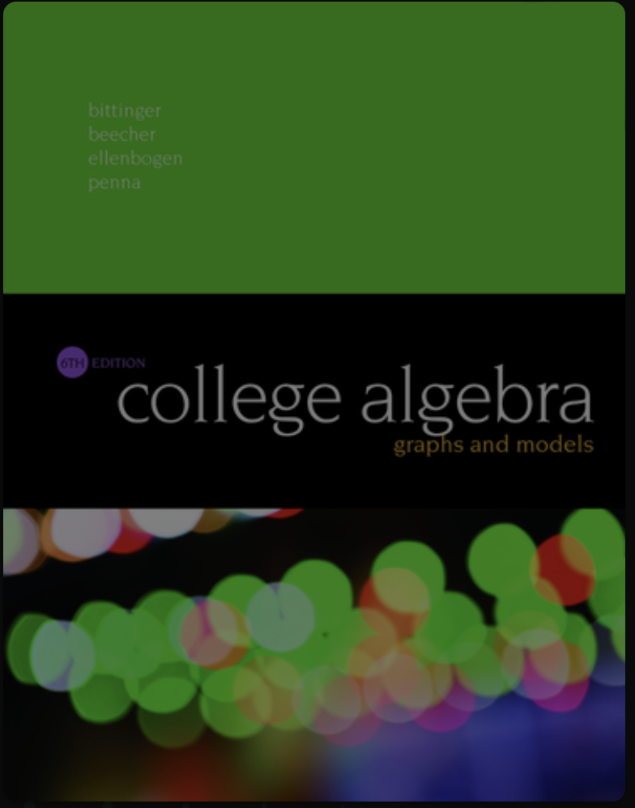
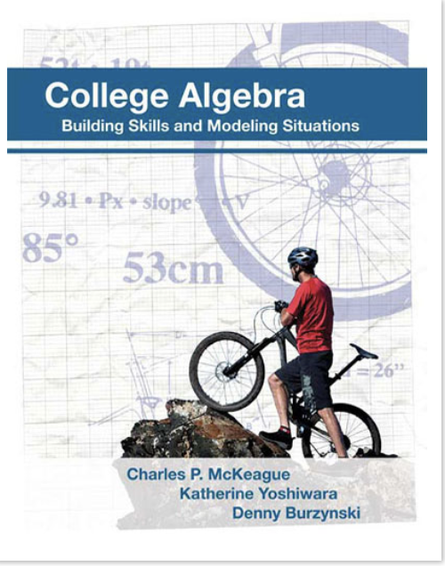
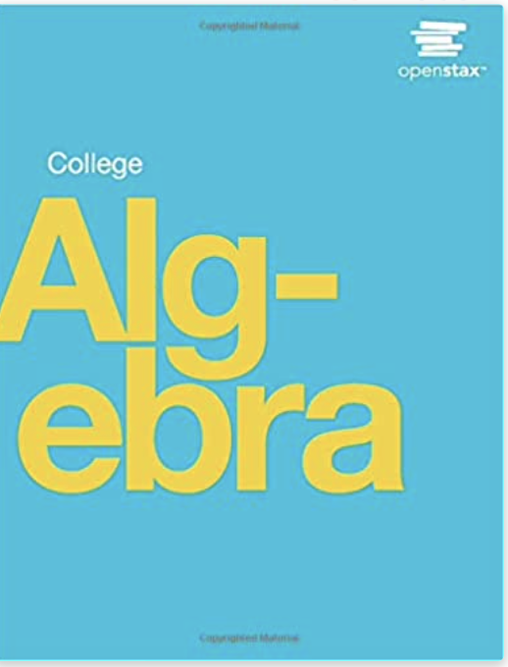
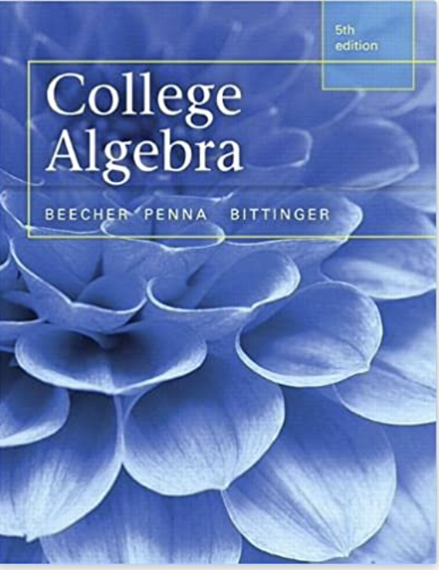
The assignments can be used with any
124 or 126 textbooks

Slide 22
WolframAlpha is a computer algebra system, an “answer system” developed by Wolfram Research.

Slide 23
Go to
https://www.wolframalpha.com/tour

Slide 24
The assignments introduce the WolframAlpha commands
evaluate
solve
simplify
rref
sum of
expand
plot piecewise
approximate
root
rationalize

Slide 25
In my classes, I start Day 1 with a Practice Problem.
The students need only do something and turn it in to get credit.
The idea is to get them to open W|A and type a command and write the solution following exactly the directions. I correct the assignment in class, so they know if they did it right or did something incorrectly.

Slide 28
Let’s use W|A
Example Problems

Slide 29
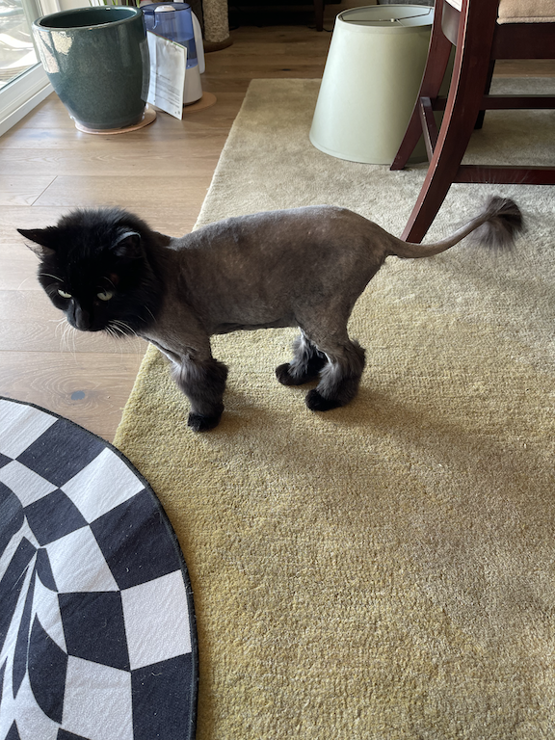
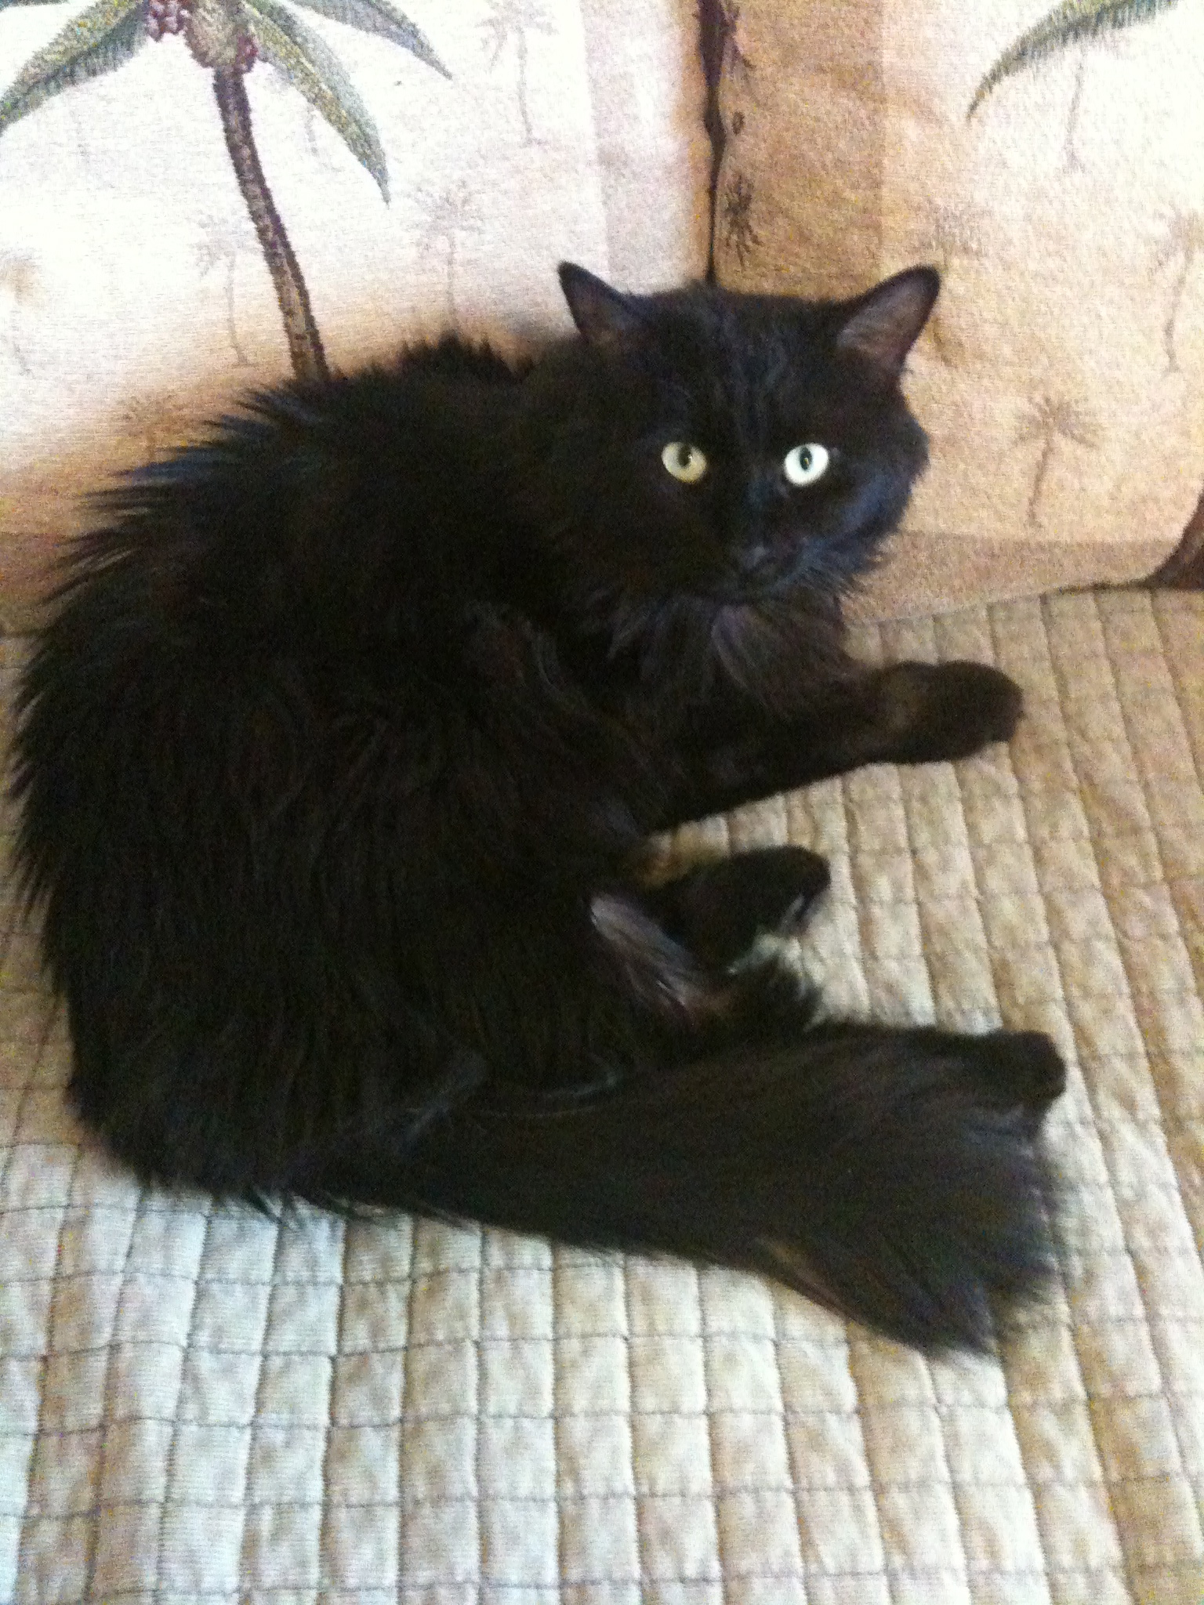
We now take a short pause to look at two pictures of my cat, Bones.

Slide 30
I asked to make this presentation because I want to encourage the extensive use of technology in non-STEM mathematics courses.

Slide 31
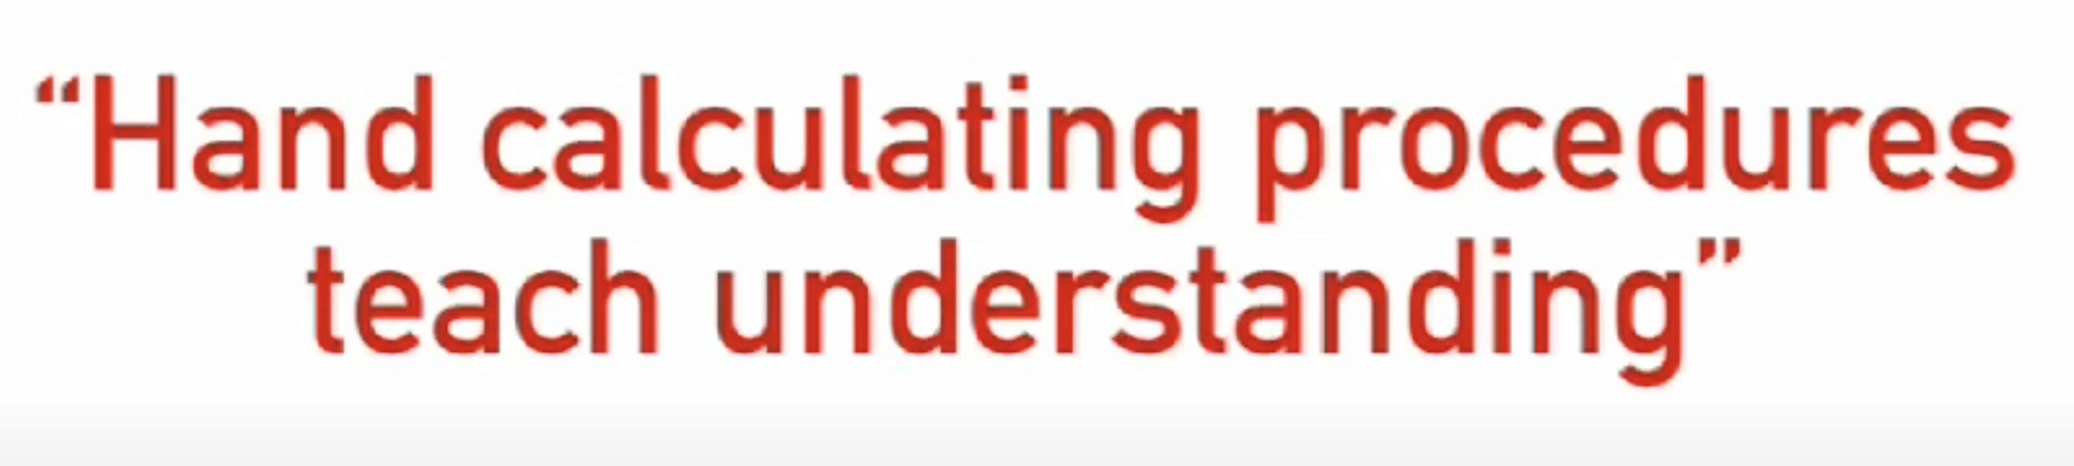
Conrad Wolfram in his TED Talk
Stop Teaching Calculating, Start Teaching Math
There is the idea that is commonly promoted that hand symbol manipulation teaches understanding.

Slide 32
If you work lots of examples, you will get to better know how the system works.
It is important to understand procedures and processes.

Slide 33
If you work lots of examples, you will get to better know how the system works.
It is important to understand procedures and processes.
But we can teach procedures and processes by teaching programming.

Slide 34
If you work lots of examples, you will get to better know how the system works.
It is important to understand procedures and processes.
Teach procedures and processes by teaching programming.
You really understand the math if you can write a program to do it.

Slide 35
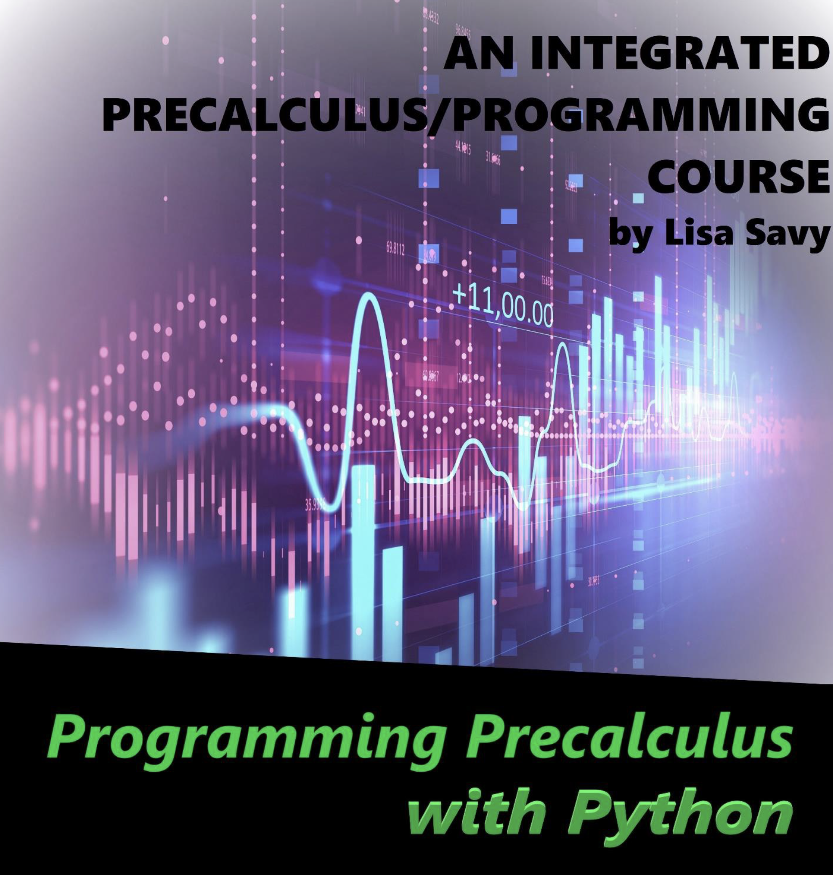
In Lisa Savy’s (CSN) Math 126 class, she teaches her students to write Python programs to work though mathematics problems

Slide 36



I had a 30-year career at West Valley College in the Silicon Valley and 10 (great)^2 years at The College of Southern Nevada in Las Vegas.
I have been most fortunate to know and work with some of the most creative and wonderful people on the planet
My sincere thank you

Slide 37
The End

